Slide 1
Implementation of Various Cryptographic Algorithms
Name : Sudireddy Shravya
Institute : IIEST Shibpur
Professor:Dr. Nirnay Ghosh

Slide 2
Known Plaintext Attack
The known-plaintext attack (KPA) is an attack model for cryptanalysis where the attacker has access to both the plaintext (called a crib), and its encrypted version (ciphertext).
These can be used to reveal further secret information such as secret keys and code books.

Slide 3
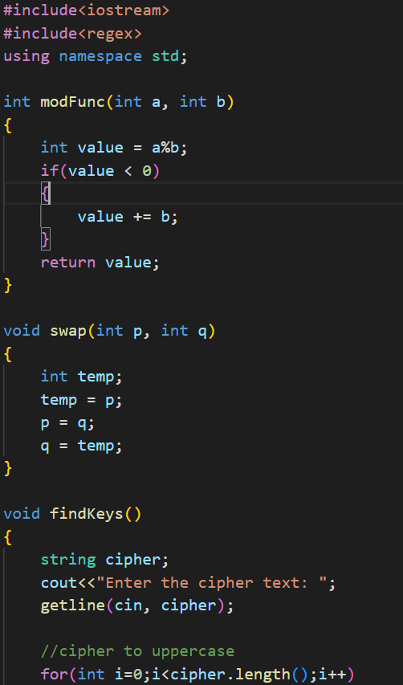
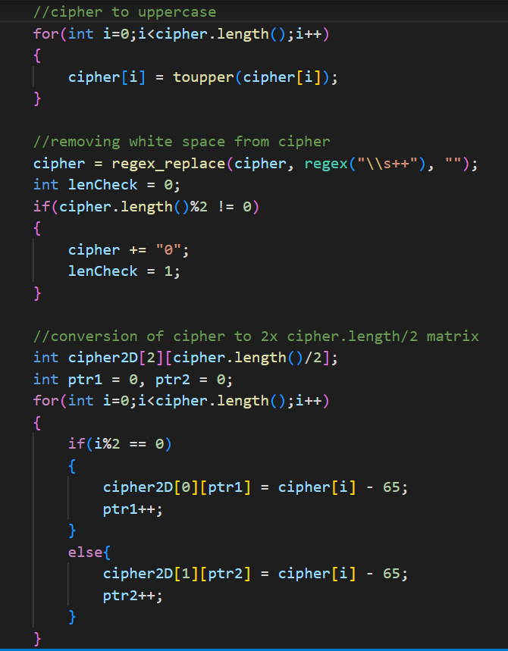
C++ Code for Known Plaintext Attack on Hill Cipher:

Slide 4
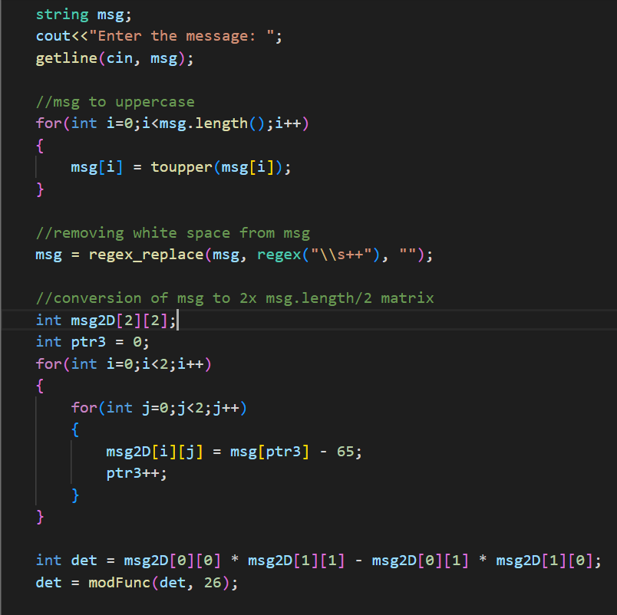
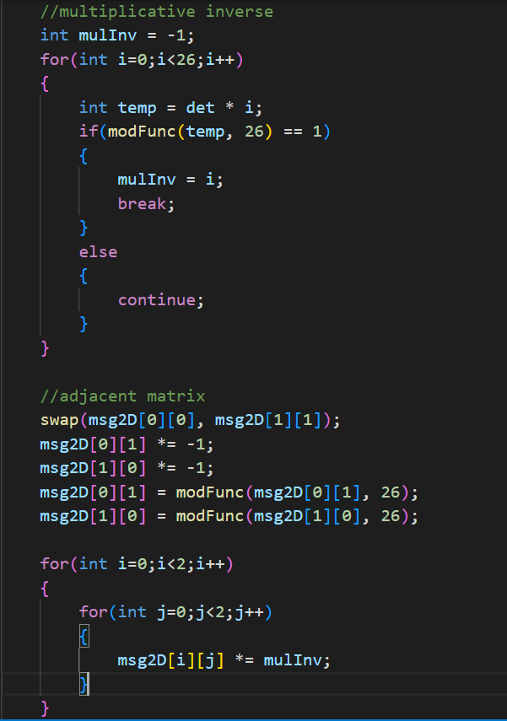

Slide 5
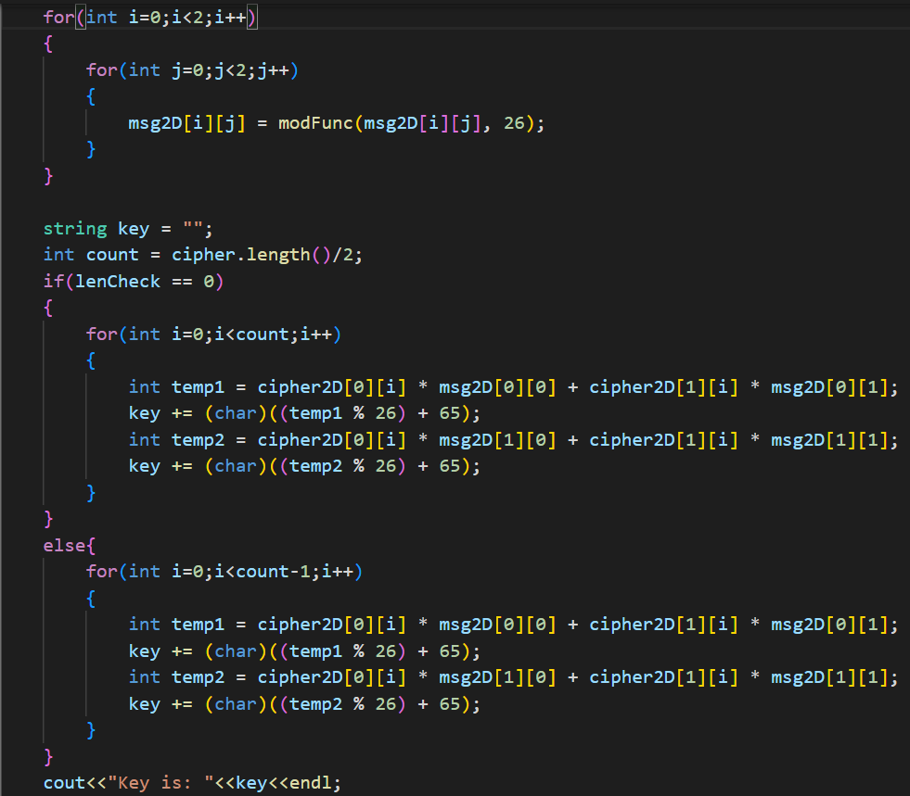
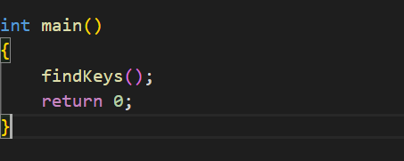

Slide 6
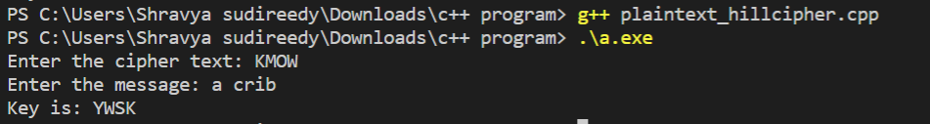
Result:
In this as we see above we get the key by known plain text and some part of cipher text by inverting the plaintext matrix with cipher matrix.

Slide 7
Implementation of Advanced Encryption Standard (AES):

Slide 8
Advanced Encryption Standard (AES):
The Advanced Encryption Standard (AES), also known by its original name Rijndael is a specification for the encryption of electronic dataestablished by the U.S. National Institute of Standards and Technology (NIST) in 2001.It supersedes the data encryption standard(DES) and it is a symmetric key algorithm.
AES is a variant of Rijndael, with a fixed block size of 128 bits, and a key size of 128, 192, or 256 bitsThe key size used for an AES cipher specifies the number of transformation rounds that convert the input, called the plaintext, into the final output, called the ciphertext. The number of rounds are as follows:
10 rounds for 128-bit keys, 12 rounds for 192-bit keys and 14 rounds for 256-bit keys.

Slide 9
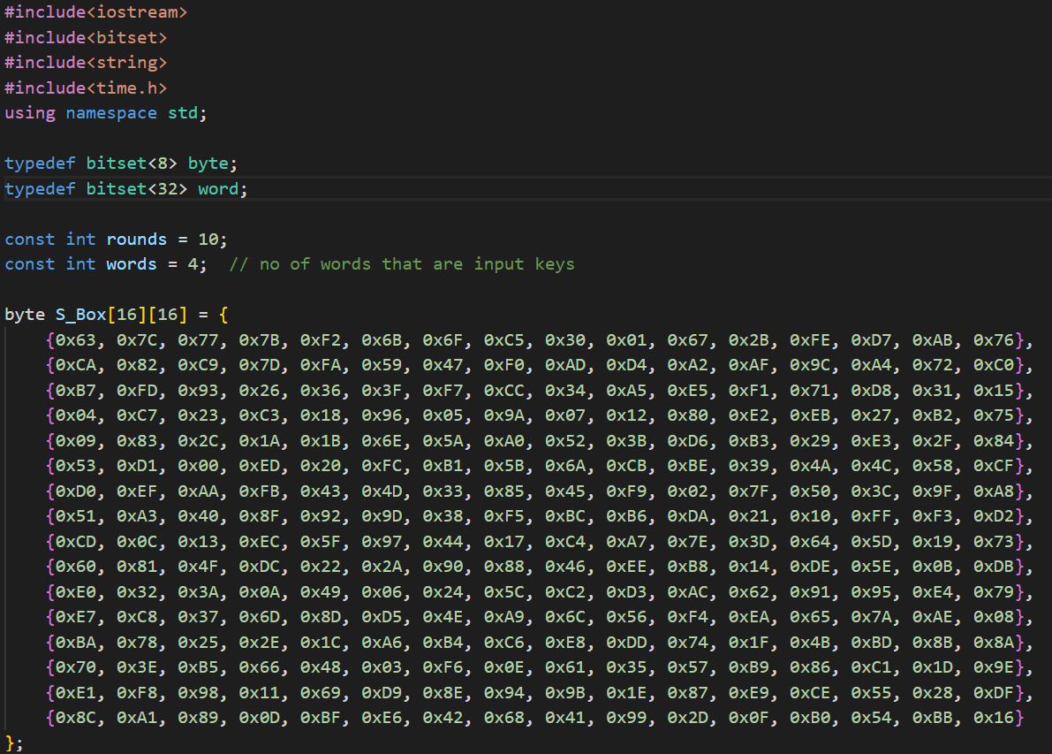
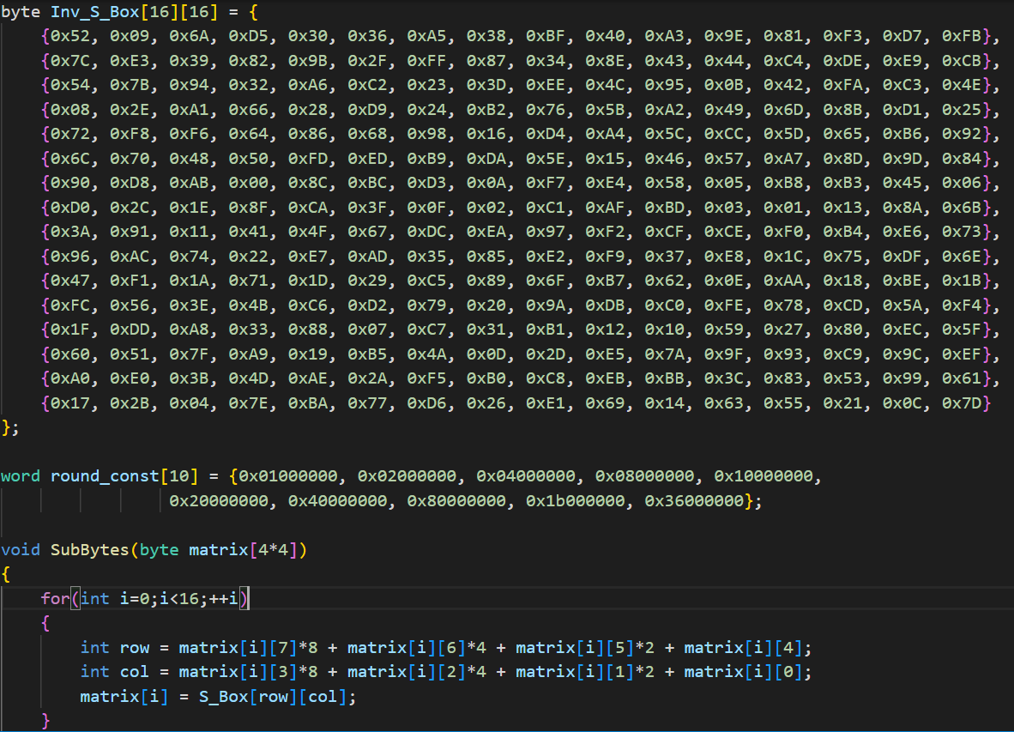
C++ Code of Implementation of Advanced Encryption Standard (AES):

Slide 10
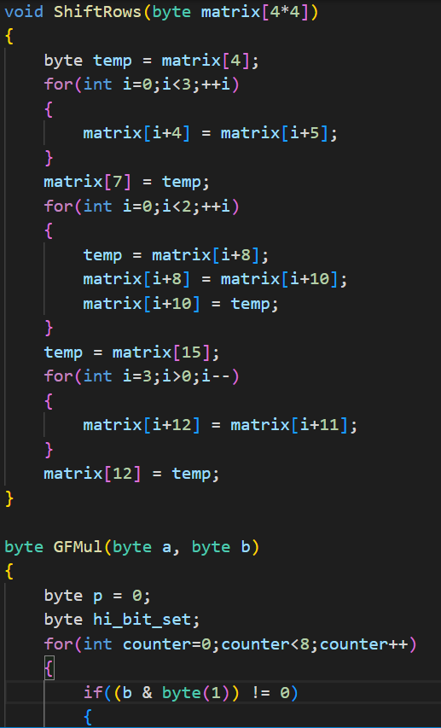
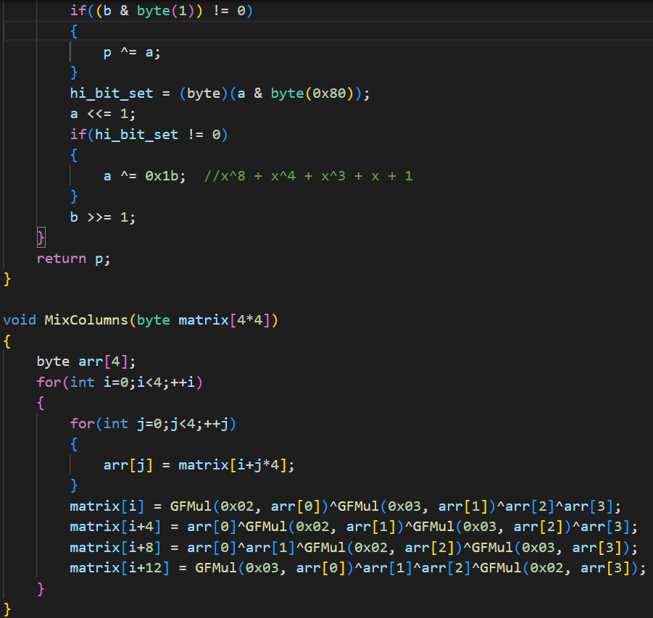

Slide 11
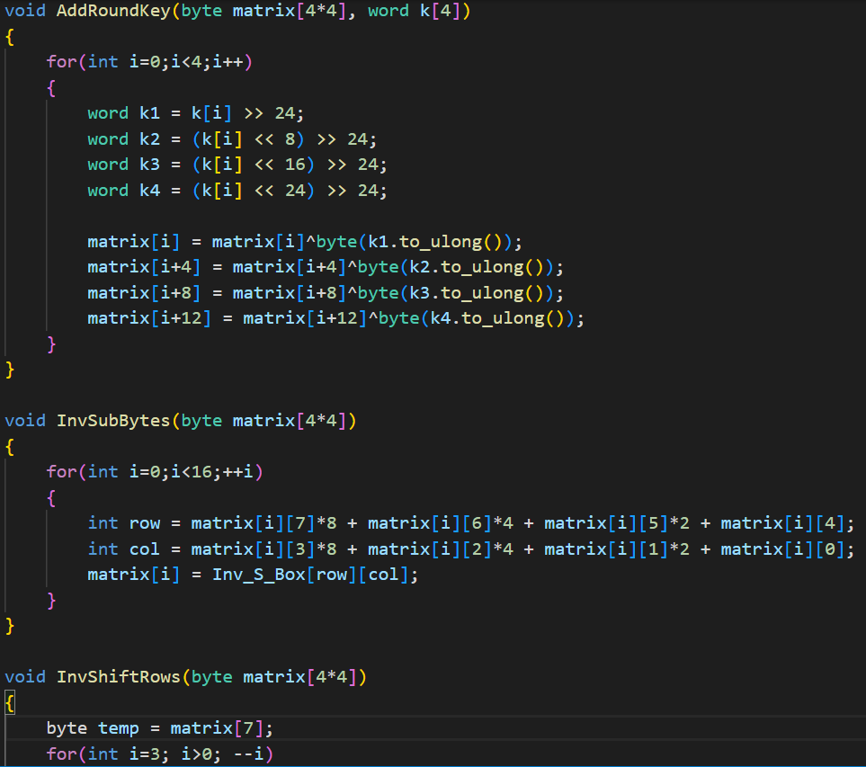
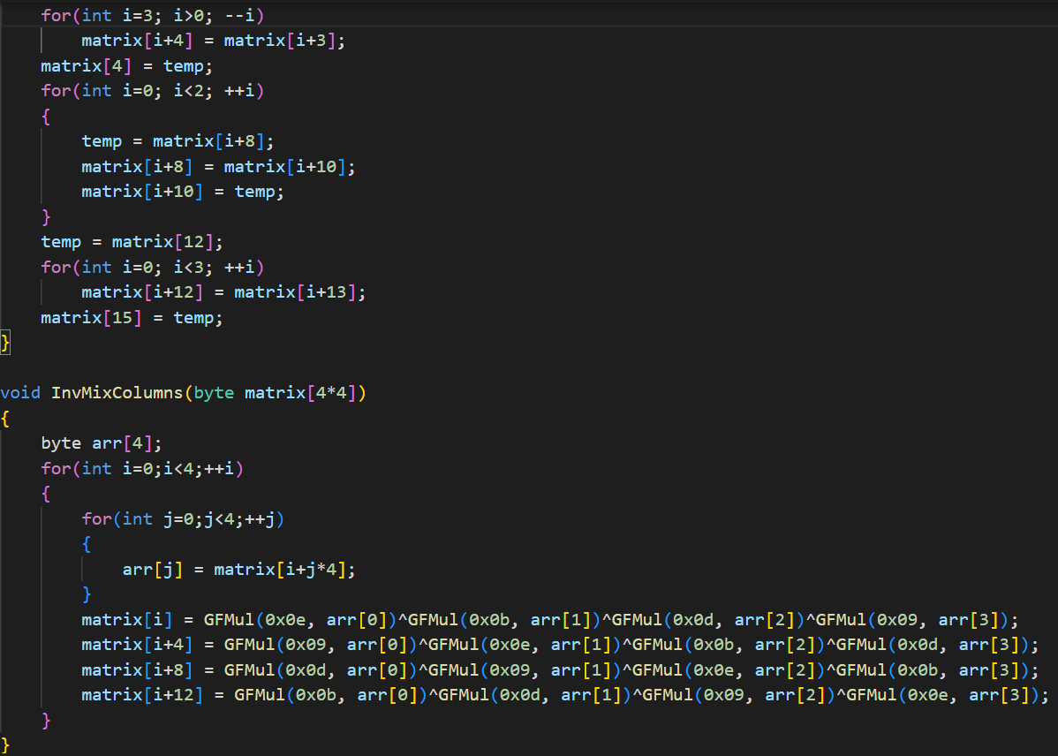

Slide 12
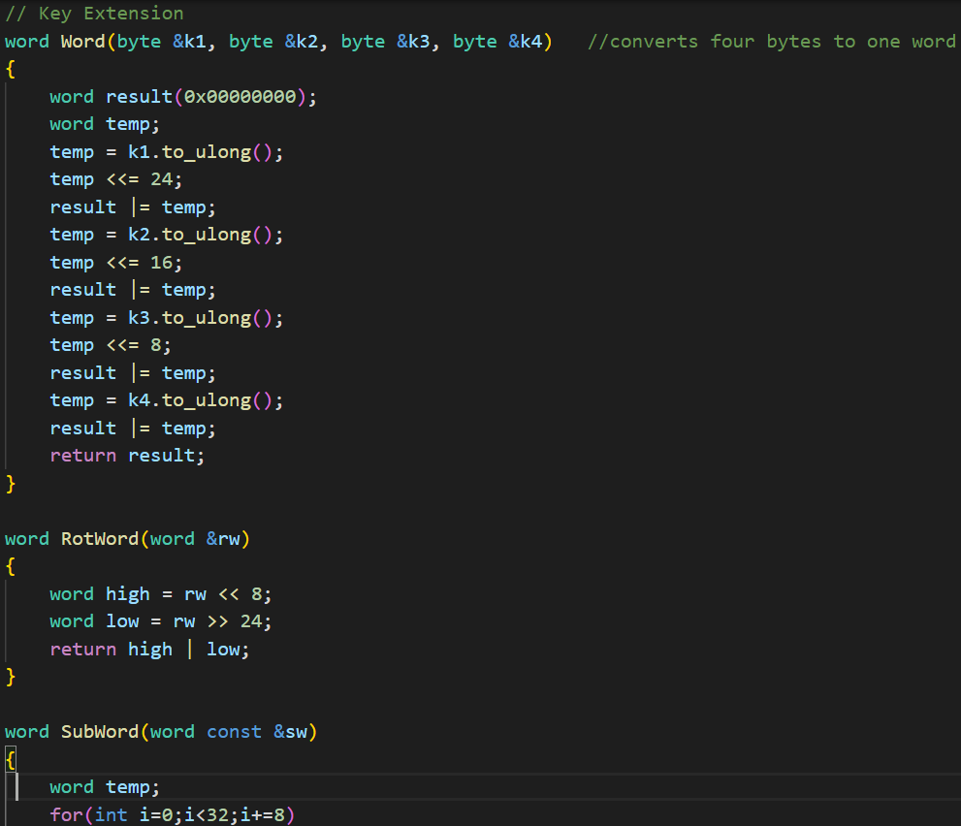
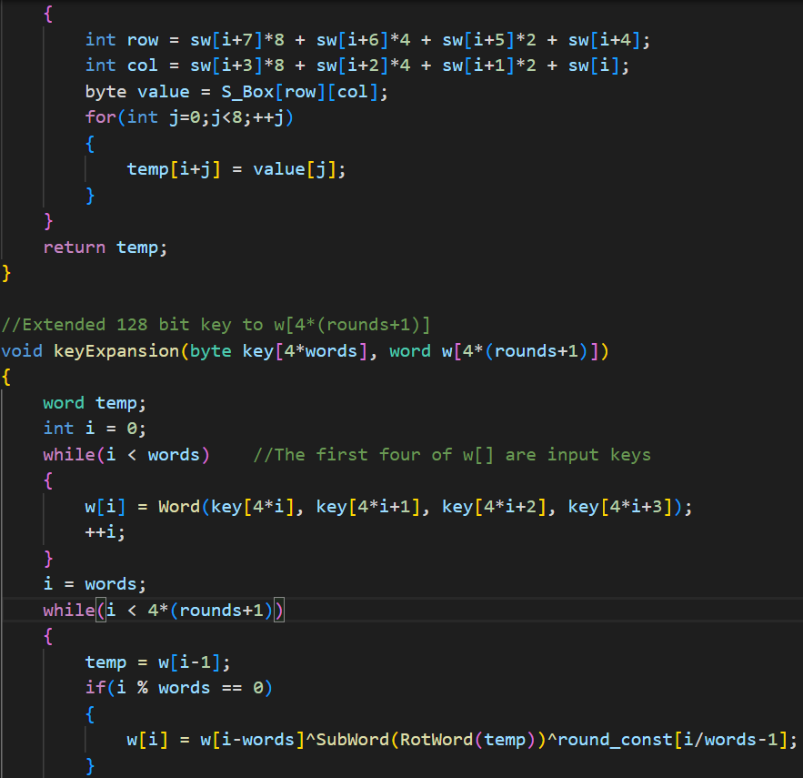

Slide 13
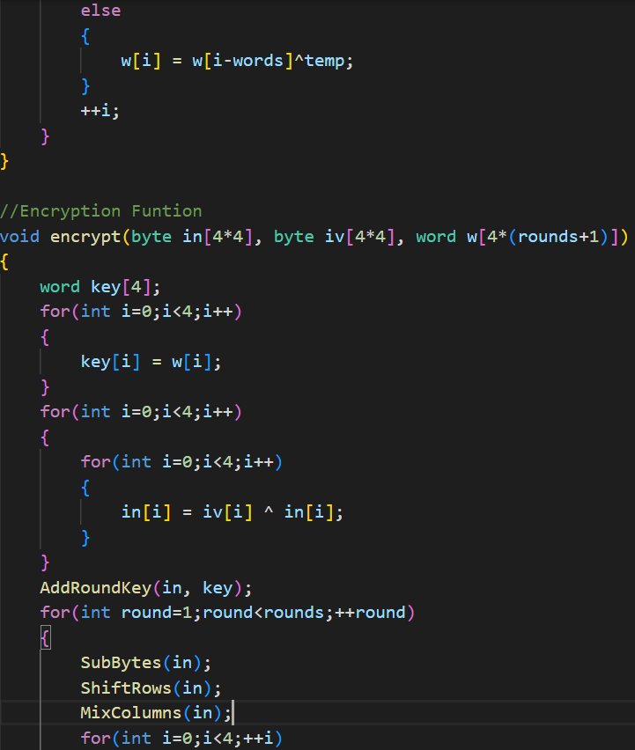
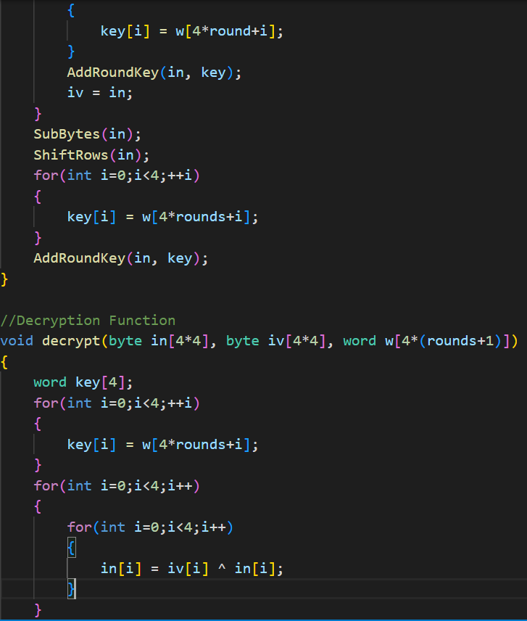

Slide 14
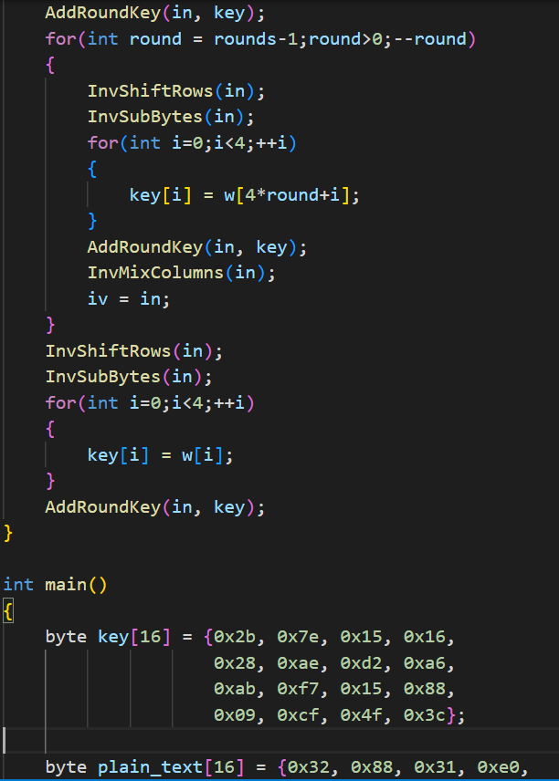
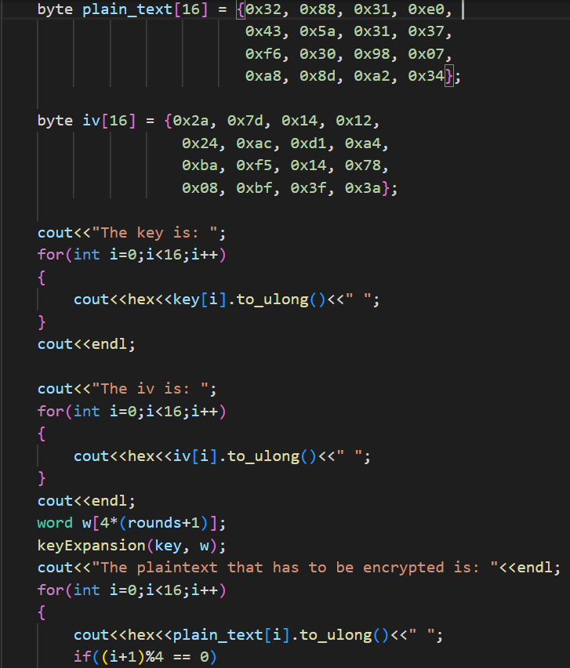

Slide 15
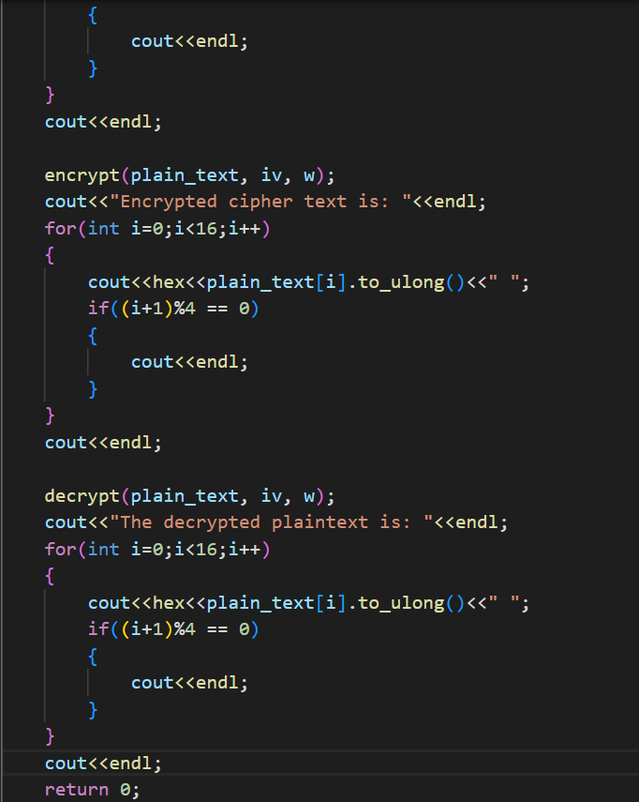

Slide 16
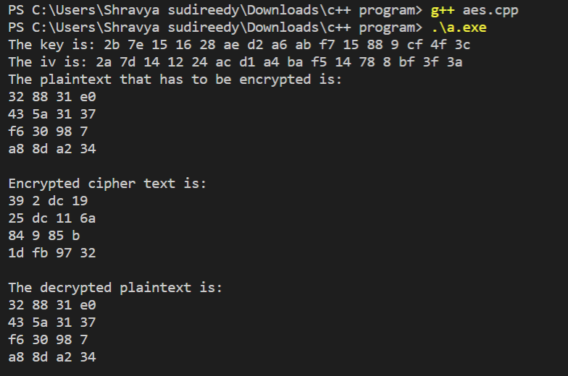
Result:

